Slide 1


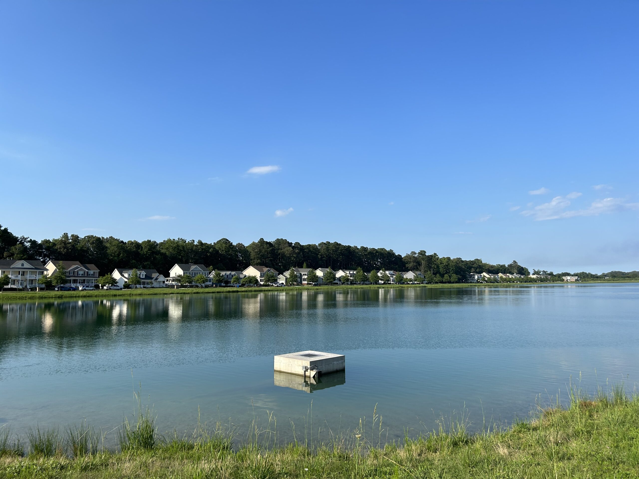
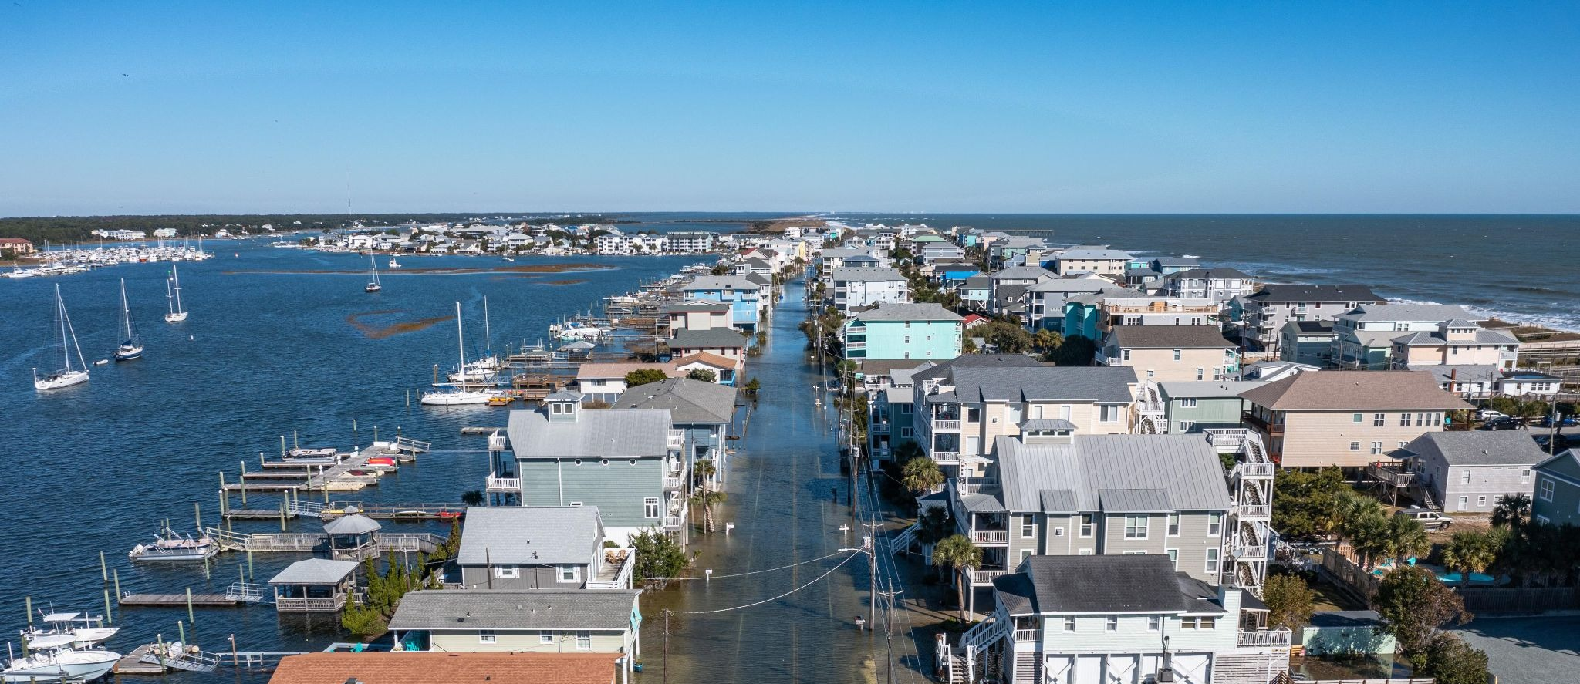
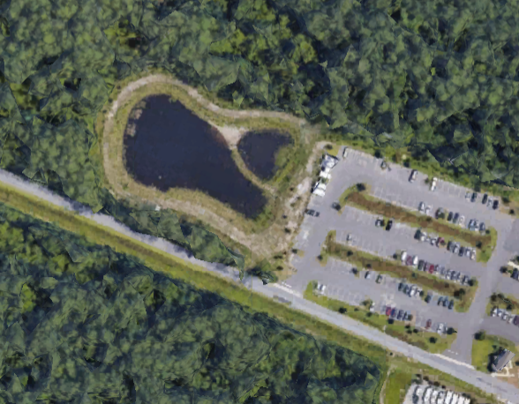
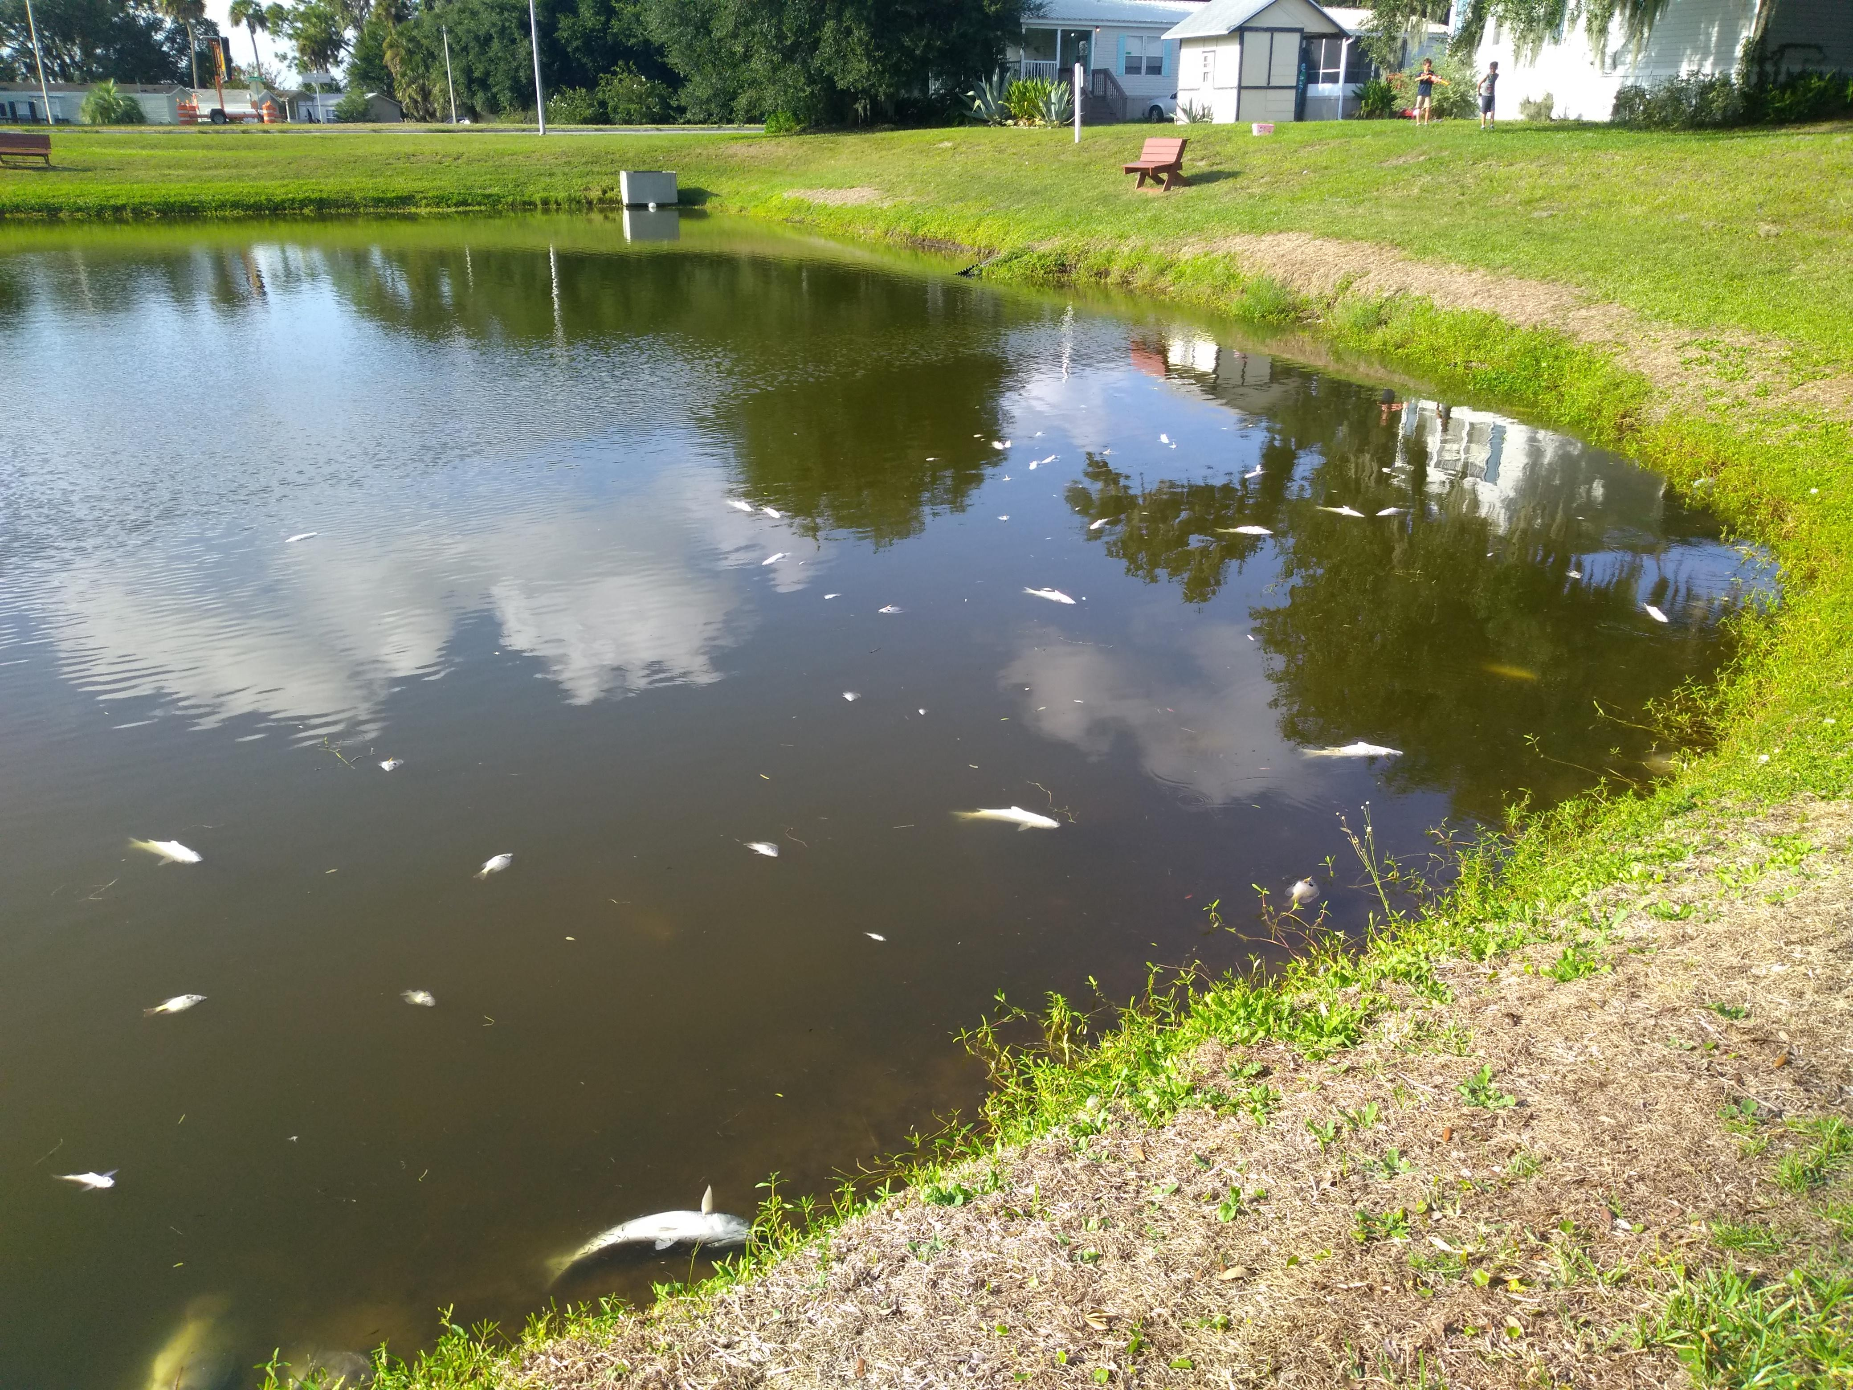
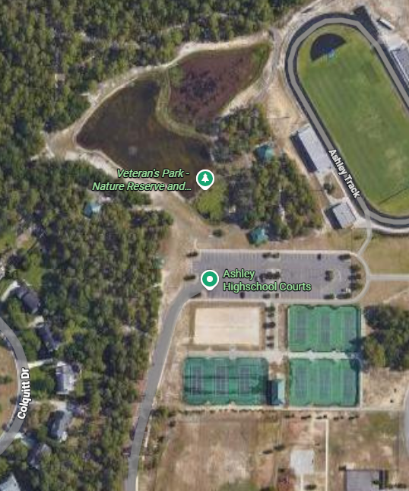
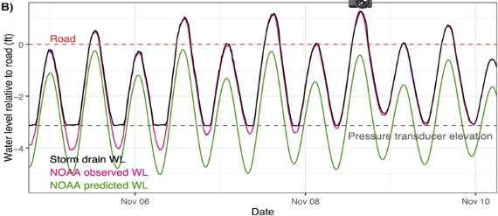
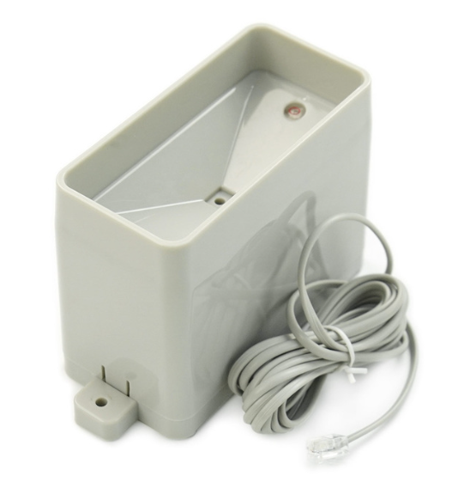

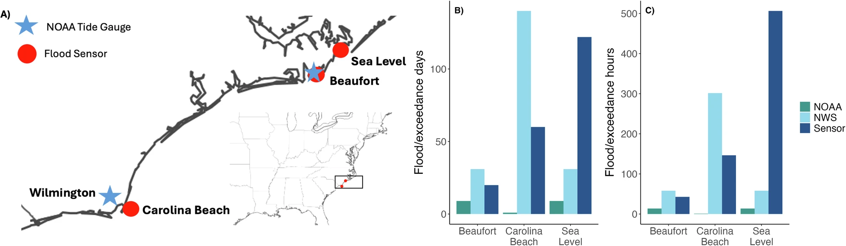
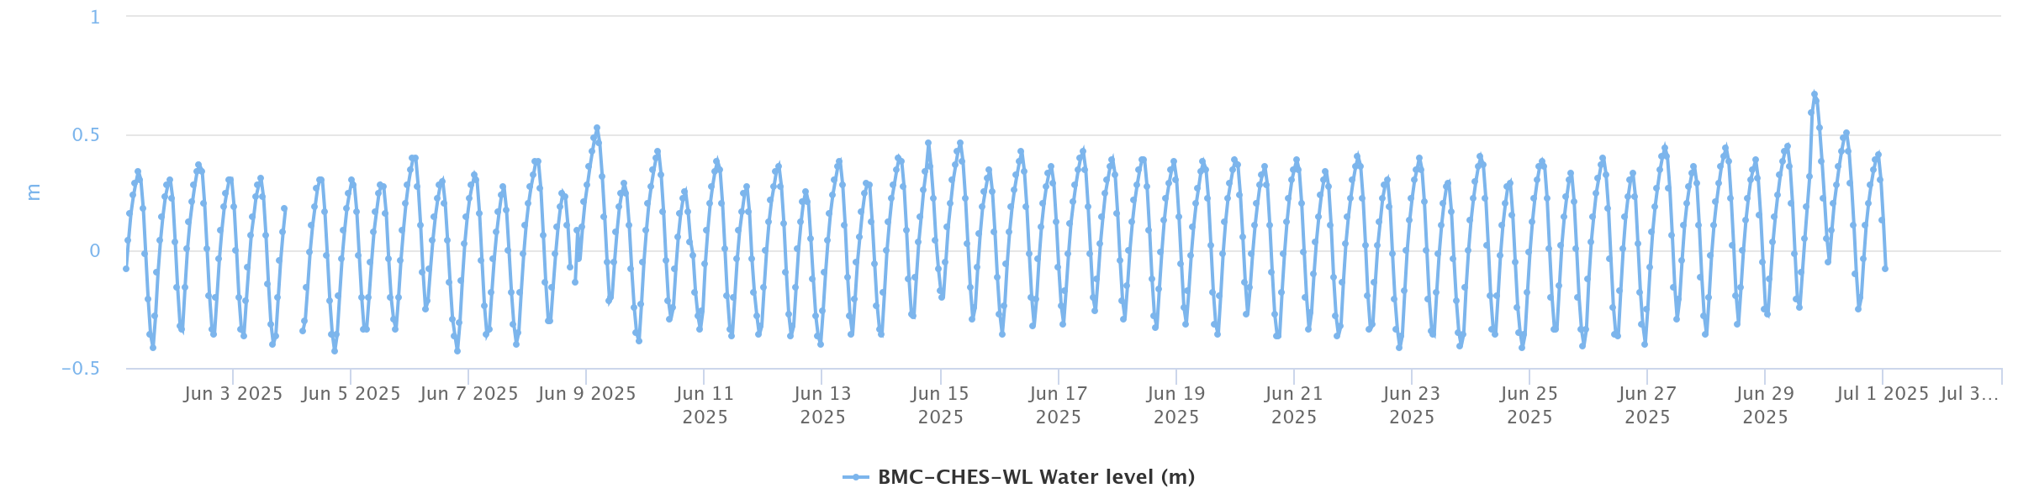
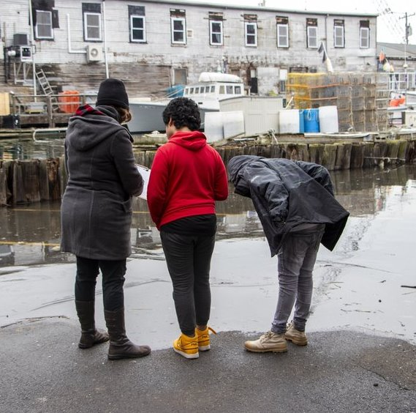
Research on Two Wilmington Retentions Ponds to Enhance Community Resiliency through Monitoring and Retention Ponds
Bentley Settin, Troy Frensley, Phil Bresnahan, Strephanis Tiztel
University of North Carolina Wilmington
Flood Drivers in Wilmington
Retention Pond at Ashley Highschool
Retention Pond at CMS
Global and Relative Changes
What are global and relative changes occurring that impact our community?
Make sure define terminology that the public may not know (i.e. Relative sea level rise, thermal expansion, etc.,)
Is there data to support this? If so, what data?
Retention Ponds
What are retention ponds?
What is the purpose of retention ponds?
What impacts the longevity and success of these ponds (size, depth, etc.,)?
What should be considered when using retention ponds for flood control?
It may be helpful to include how many retention ponds we have in Wilmington !
Where is this pond located? What is around this pond?
Tell us about the recent failure of this pond based on the news report. It may be helpful to include a picture of this too!
What is the estimated volume this pond can hold? This will be calculated based on the google earth measuring tool and our previous formula from lesson 3. You will assume that your pond is 4 feet deep also.
What influences how much water goes into this pond? For my example I would discuss the large parking lot that causes water to runoff into this pond. The sediment near the trees may also flow into this pond.
Coastal Changes​
What are specific changes we are seeing on our coastline?
Discuss storm events (if not already mentioned), impervious surfaces, and pluvial flooding.
What if all these factors occurred at once? ​
Retention pond at UNCW
Carolina Beach, NC Chris Pilloton via Coastal Observer
Ashley Highschool Retention Pond
What is the estimated amount of water this pond can hold?
Specific to this pond, what is near the pond that could impact how much water goes into it?
What creek or river it is helping protect?
Retention pond at CMS
You can include a figure that displays this data alongside the text. Make sure if you use a graph or figure that you can explain it when asked! All figures should credit where it is from.
Gold et al., 2024
Retention Pond at AHS
Sensor Deployment and Data
What type of sensor did we deploy?
Why are these parameters important to monitoring to help with flood control?
What qualities about this sensor are important for use? Is it real-time? Using cellular? Open to the public?
Our Recommendations
Resiliency Strategies in Wilmington
What is resiliency? What is coastal resiliency?
Based on the news article what are realistic steps you would take to make this pond more efficient for flood control and creek protections?
You will need to be very specific here, it is as if you are building out a resiliency plan that a government official can pick up and implement. For example, If you think there should be more native species, specific which species. If there should be a specific soil type, which type and why?
What public strategies would you enforce or create in order to engage the public in helping protect this pond.
Rainfall tipping Bucket Sensor
Monitoring Gaps
What are the current issues flooding monitoring can address?
There is a lack of spatial flooding data in this area (e.g., extent, frequency).
NOAA and NWS provide standard thresholds that lack spatial resolution (Gold et al., 2022, Hino et al., 2025 (figure below)).
How could closing monitoring gaps and deploying more flood sensors help?
Ultrasonic Distance Sensor
References in APA format
In-text example:
Global mean sea level rose by approximately 1.5 mm per year, from 1900 to 2018(Frederikse et al., 2020)
APA reference examples you would place in this section:
Anh, N. T., Can, L. D., Nhan, N. T., Schmalz, B., & Luu, T. L. (2023). Influences of key factors on river water quality in urban and rural areas: A Review. Case Studies in Chemical and Environmental Engineering, 8, 100424.
Brown, B. B., Altman, I., & Werner, C. M. (2012). Place Attachment. International Encyclopedia of Housing and Home, 183–188.
Figure showing precipitation and water level values in March at AHS
2. Stormwater Infrastructure
What is stormwater infrastructure? What are some examples?
What is the general purpose of implementing stormwater infrastructure?
Gold et al., 2024
Our data
What is happening in the figure above?
If there was an obvious rain event, show us! If there was not an obvious event explain what you would expect to see?
GMRI
References
Notes:
Talk about lesson plans, maybe include QR code,
Maybe include photo or testimonial of Governor School, Emma.
Poster: - thematic title instead of just background
Look for places to streamline
Maybe too many points? Bigger arrows please
To address the challenges above…You will see an overview of our two-pronged approach instead of a whole paragraph. Maybe just this is what we do!
Can add a picture of a kid.
Put into text how Hino figure ties to.
Deployment for one will be at retention ponds at school and a test field site for validation purposes.
May need to say why retention ponds… stormwater and ease of access
“Purpose section”
Maybe label limitations or challenges or assumptions where I lay bare some of the challenges associated with building sensor. Same for education side, limitations are can only work with one group, this is a draft so would need more people. What questions can other people help me answer.
Put EMAIL SOMEWHERE. May need to add affiliations.
Our approach to building coastal resiliency instead of “Coastal Literacy”
Maybe have numbers within this section that correlate to plan
Might consider having educational background.
Maybe instead of Purpose… Looking Ahead, Future Directions, Anticipated Project Outcomes
Consider how framing stuff.
Lesson plan
Say who I am working with, just age
What they will participate in
List out lessons with general theme and activities
With lesson 4 say (4 weeks later)
Included Anticipated outcomes
Pre experience and psot experience survey
Embedded evaluation approach (poster) and teacher survey

